Slide 1
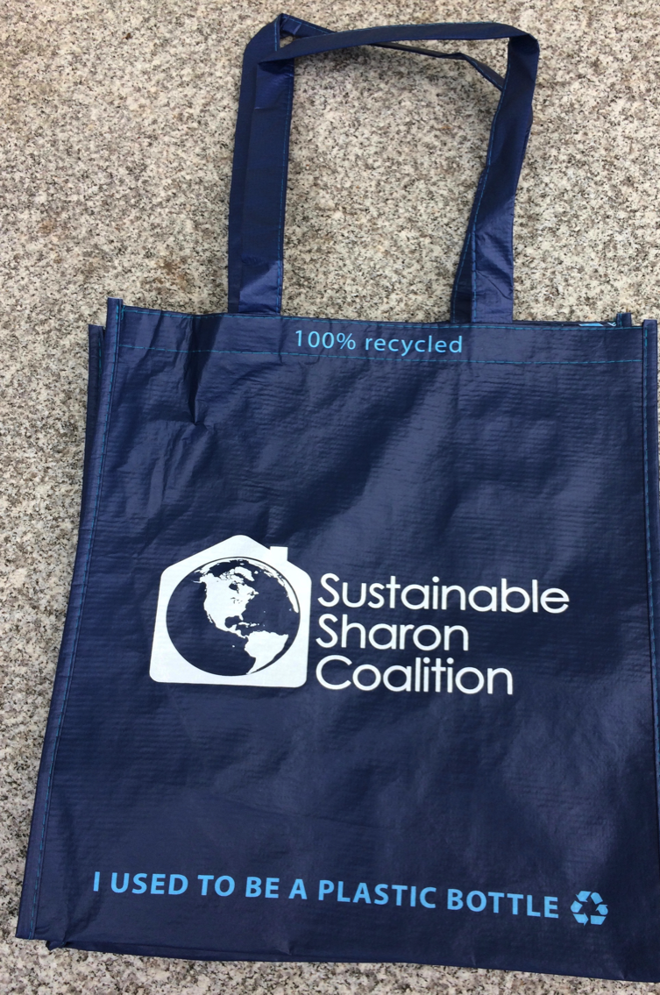
VOTE YES! ARTICLE 23 Sustainable Sharon Coalition & Plastic Free Sharon
BYOB
Bring Your Own Bag
Notes:
Thank you Andy and Pat, Ladies and Gentlemen
The overall goal of Article 23 is to promote the use of reusable shopping bags in the Town of Sharon, and also to spread awareness of our global plastic waste crisis.

Slide 2
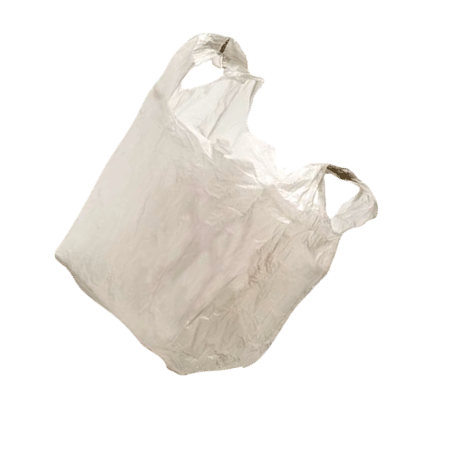
Sharon Plastic Bag Reduction Bylaw
NO thin-film plastic checkout bags at retail stores in Sharon
Earliest start date:
November 6, 2019
1 year for small retailers
Across MA:
101 cities & towns have approved similar Bag Laws
Statewide Act:
under consideration
Notes:
Specifically it stipulates that…. READ

Slide 3
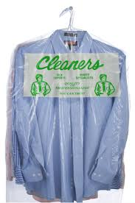
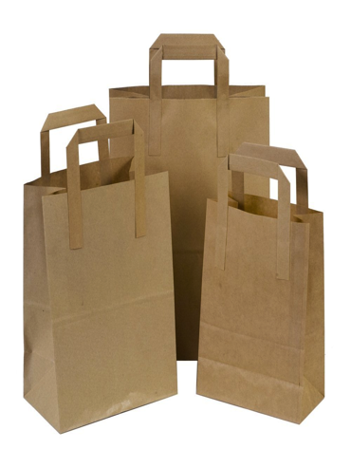
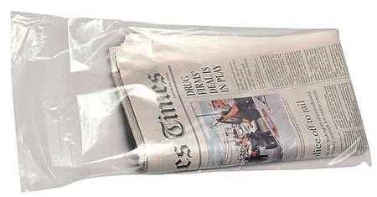
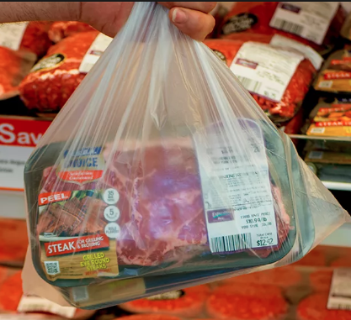
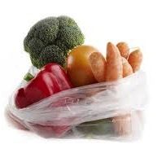
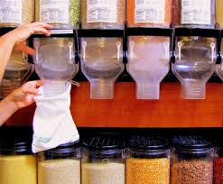
Bags that will still be available
Notes:
, if you forget your reusable bag….Paper bags will still be available at checkout –
Not best option because even paper bags made from recycled paper have environmental impacts from their production, shipping and recycling.
Within the grocery store you will be able to get plastic bags for meat, produce and bulk food.
Dry cleaning and Newspaper bags will still be available

Slide 4
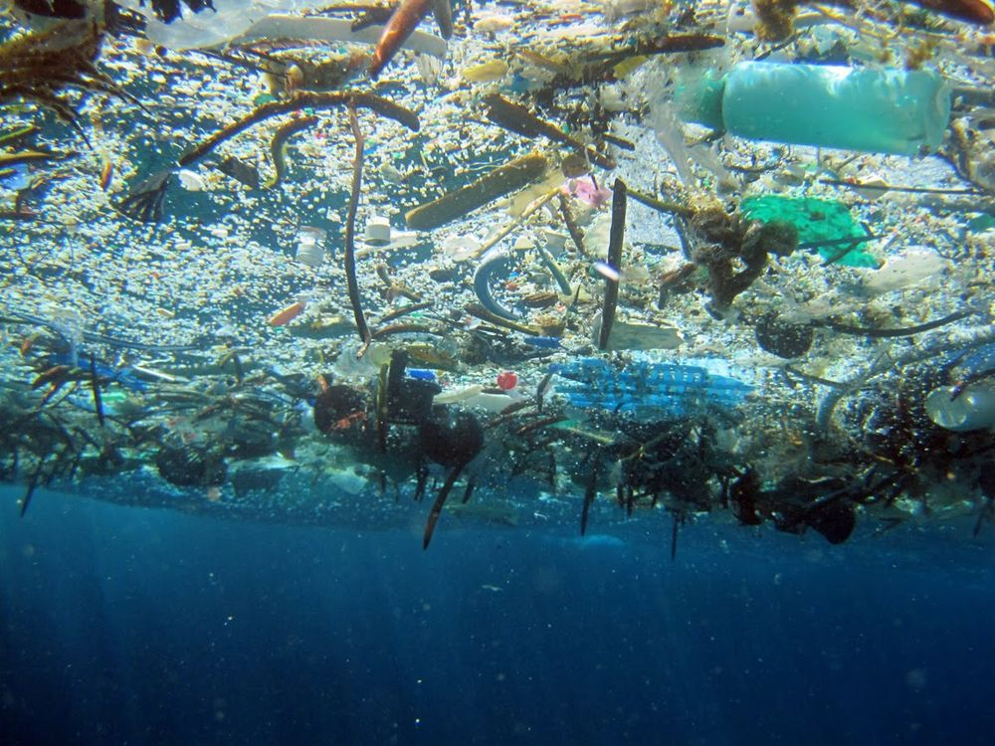
Plastic does not biodegrade:
It accumulates
NOAA Image: Great Pacific Garbage Patch
Notes:
The main problem with plastic is that It does not biodegrade,
with no microorganisms to break it down it lasts centuries, essentially forever and accumulates in landfills and the natural environment.
This is plastic floating in the GPGP as seen from below.
This garbage patch is the size of Texas, and 1 of 5 worldwide

Slide 5
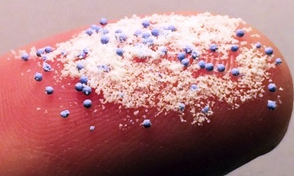
Microscopic plastic pollution: Health concerns
Break down into “microplastics” that bind toxins-
(DDT, PCBs, etc)
Toxic microplastics
accumulate in oceans
Food chain
You!
Zooplankton
& marine animals
eat microplastics
Alimi et al. Microplastics & Nanoplastics in Aquatic Environments: Aggregation, Deposition, & Enhanced Contaminant Transport. Environ. Sci. Technol. Lett. 52:1704, 2018
Notes:
There’s also the invisible problem of plastic pollution.
Although plastic isn’t biodegradeable sunlight does break it down into small pieces “MPs”
These plastic pieces bind hydrophobic toxins like DDT, PCBs and heavy metals and these last forever
Microplastics and bound toxins accumulate in Oceans, where it is eaten by and move up the MARINE food chain to your dinner plate

Slide 6
Too much plastic!
8.3 billion metric tons produced worldwide
(1950 – 2015)
6.3 billion tons plastic waste
9% Recycled
12% Incinerated
toxic emissions
79%
5 billion tons for disposal
landfills & litter
(25 tons/sq mile Earth)
Geyer et al. Production, use, and fate of all plastics ever made. Science Adv. 3: July 2017.
Notes:
Another piece of the plastic problem the staggering amount of plastic waste being generated worldwide!
In the last 65 years since production began, 8 billion tons of plastic have been produced worldwide
6 billion tons of it became plastic waste!
Only 9% was recycled
12% incinerated, another huge problem as it releases toxins such as Hg PCBs
That means most plastic waste, 5 billion tons was sent to landfills, or as we know ended up as litter
It this seems like a big number it is, 25 tons per square mile earth, and it’s permanent

Slide 7
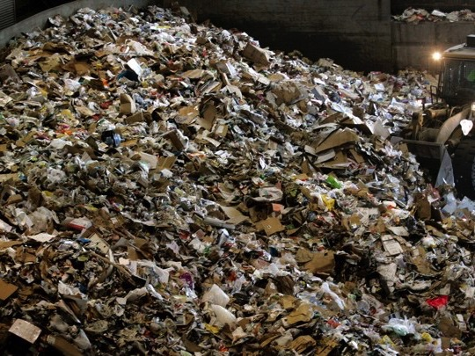
Too much plastic for planet Earth!
2018 Sharon curbside
plastic disposal
Tons | Pounds/person
700 | 77
Data from Sharon Dept. of Public Works
& MA Dept. of Environmental Protection
Notes:
but the situation now is actually worse: plastic use has skyrocketed over the last couple of decades,
And the U.S. generates a lot more plastic waste than most countries
These are estimates from our DPW and MA DEP
(town reported trash and recycling tons "disposed or recycled" in 2018
- Facility waste characterization report from Covanta for trash disposal indicates that trash is 13% plastic by weight
- Facility/commodity report from Waste Management Avon for recyclables indicates 5-10% of single stream recyclables by weight is comprised of plastics.)

Slide 8
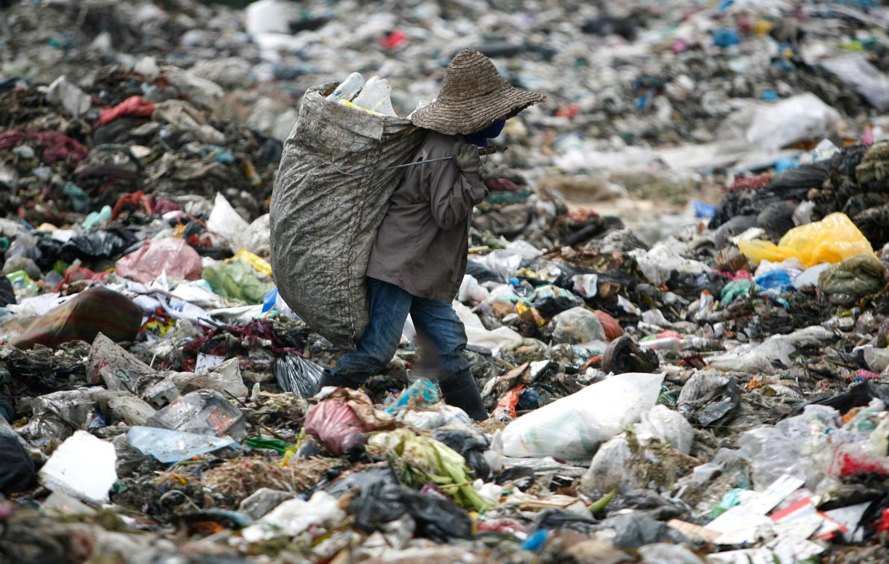
2018: China stops accepting U.S. plastic
U.S. lacks capacity to recycle our plastic
Ship it to other Asian countries:
no accountability as to its fate
(recycled, landfill/dump, incinerated?)
Notes:
In 2018… problem gets worse.
China stops… after recycling it for decades READ slide Don’t have sufficient capacity to recycle all of our plastic.
Current troubles with recycling have renewed calls for limiting plastic waste at its source, resulting in an marked increase in plastic bag bans.

Slide 9
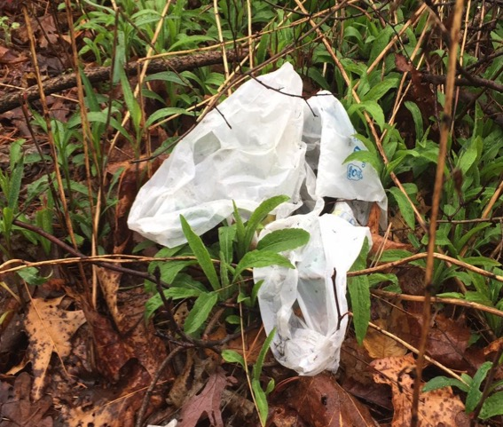
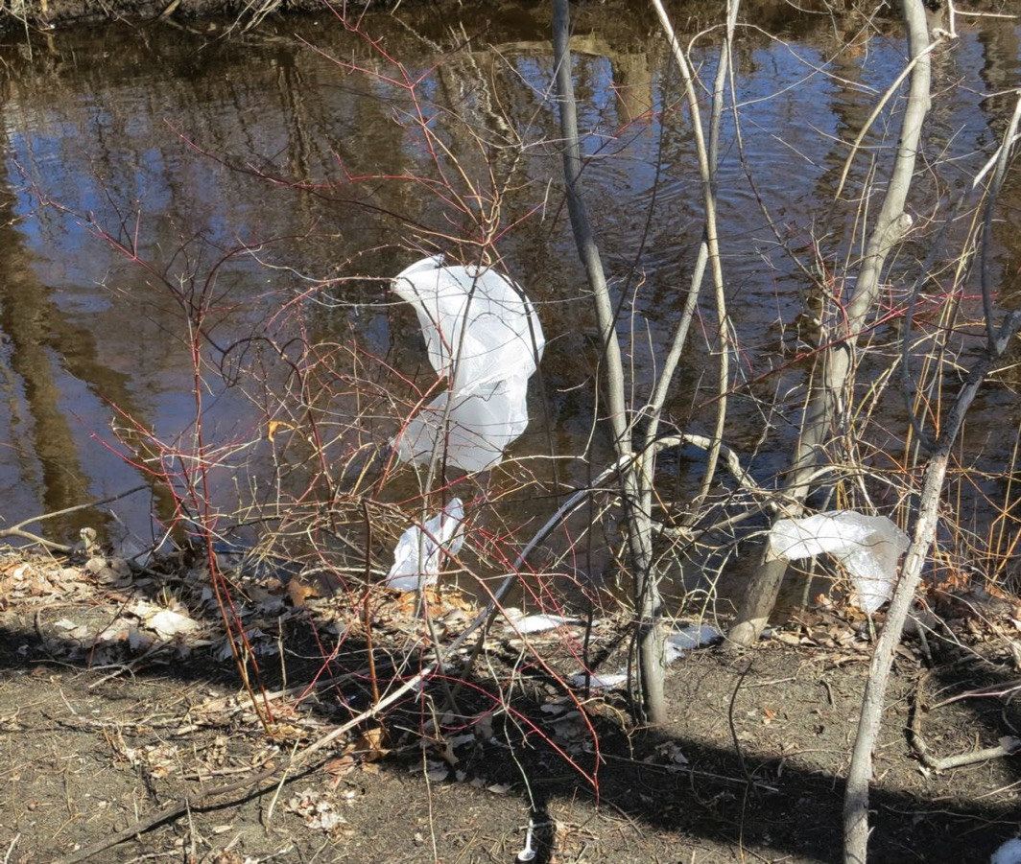
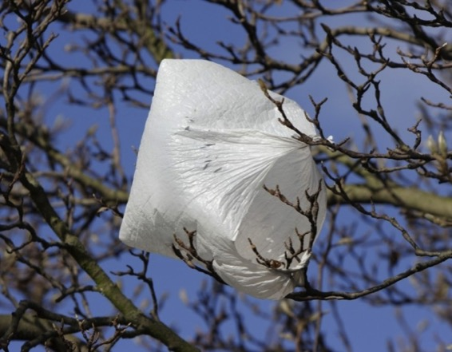
Why reduce plastic bag use?
Notes:
Why reduce single-use plastic bags specifically?
First there is the highly visible problem: Litter Because bags are lightweight they are easily blown by wind Into woods and waterways and they end up clogging storm drains

Slide 10
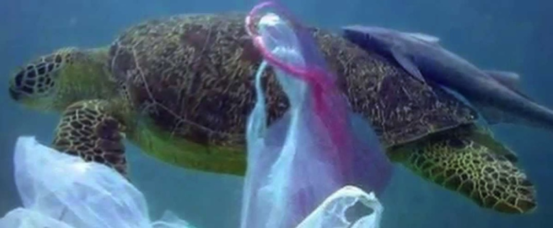
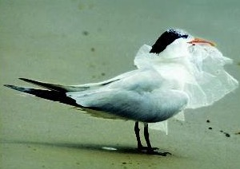
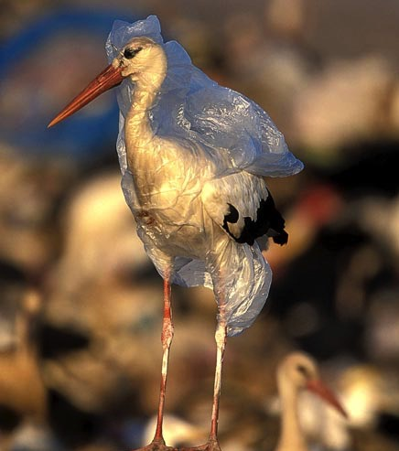
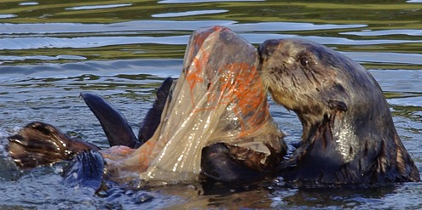
Plastic bags kill animals by suffocation, choking, intestinal blockage, or entanglement
Notes:
ALSO: Plastic bags are literally deadly to animals. READ a brutal death by
It’s been estimated that ALL of the worlds sea birds have plastic in their digestive tracts.

Slide 11
Too Many – Used Briefly & Discarded
Average Use:
12 minutes
6 million/yr
in Sharon
5 trillion
Worldwide 2019
Low-recycling rate: 1% - 5%
Best alternative: BYOB
Notes:
And then there’s the numbers. READ

Slide 12
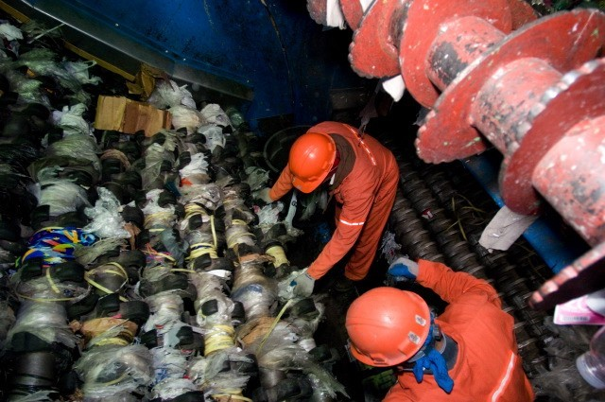
NO curbside recycling
Clog the sorting mechanism of machinery
Decrease efficiency
Contaminate products
Notes:
Also plastic bags can’t be recycled curbside, buy many are put there by mistake
Decrease operating efficiency
High risk to workers who must clear the tangled bags from the machinery with utility knives

Slide 13
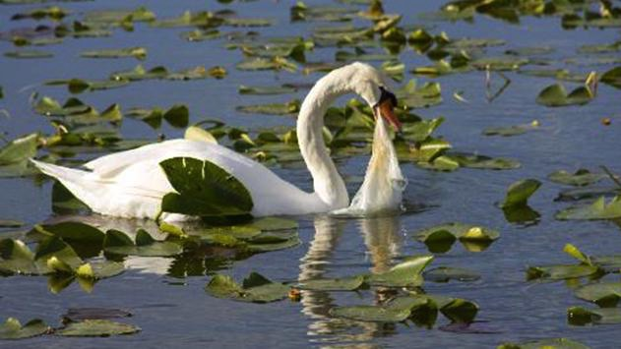
Help Keep Sharon & Our Planet Beautiful & Healthy
VOTE YES FOR ARTICLE 23
Notes:
So for all these reasons, I urge you to

